Slide 2
The
PIE TANK
B Y C O D E N A M E : P I E P R O J E C T S

Slide 3
welcome to
THE PIE TANK - CPP
THE PRESENTATION
A presentation about the project, team, and its built process.
For the animated version please visit:
https://tinyurl.com/ThePieTank-CPP
Page 02 of 20

Slide 4
table of
CONTENT
ABOUT US
WHAT IS IT FOR?
HOW IT WAS BUILT
EACH MEMBERS ROLE
LIVE DEMO
Q & A
THE PIE TANK - CPP
Page 03 of 20

Slide 5

ABOUT US
Page 04 of 20
Computer and Robotics enthusiasts
It was created in October of 2021
Codename: Pie Projects was chosen in February of 2022

Slide 6
ABOUT US
Page 05 of 20
Hazratali Seylani Ensar Yıldırım Batuhan Kaya Hasan Karaca Muhammet Güneş Maryam Hamayoon Esra Avcı
Gülseren Temel

Slide 7
THE PIE TANK - CPP
Page 06 of 20
WHAT IS IT FOR?
Mine detecting scenarios on battlefields and in battles. Find and rescue scenarios.
Delivery robot.

Slide 8
THE PIE TANK - CPP
HOW IT WAS MADE?
Page 07 of 20
3D Printed Parts Raspberry Pi 3b Lipo Battery
4 Motors
Motor Driver Board Voltage Stepper
2 Spot Lasers
Buzzer Module
Micro Python for the software

Slide 9
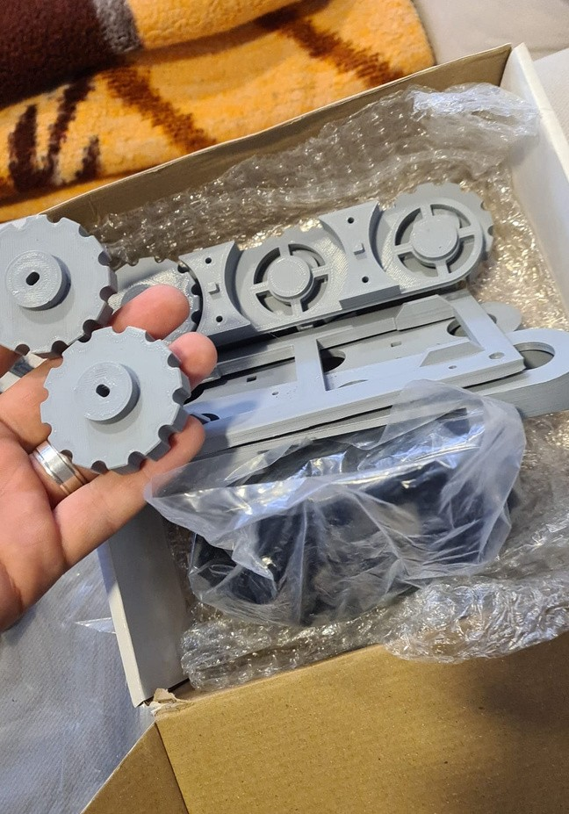
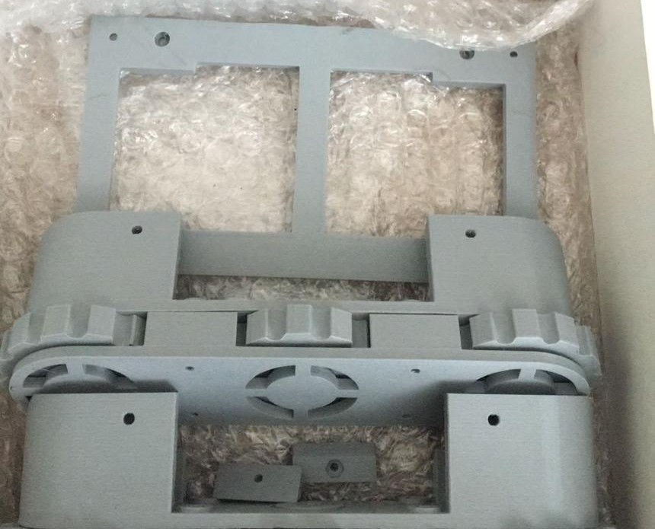
THE PARTS
Page 08 of 20
3D PRINTED CHASSIS
3D PRINTED CHASSIS

Slide 10
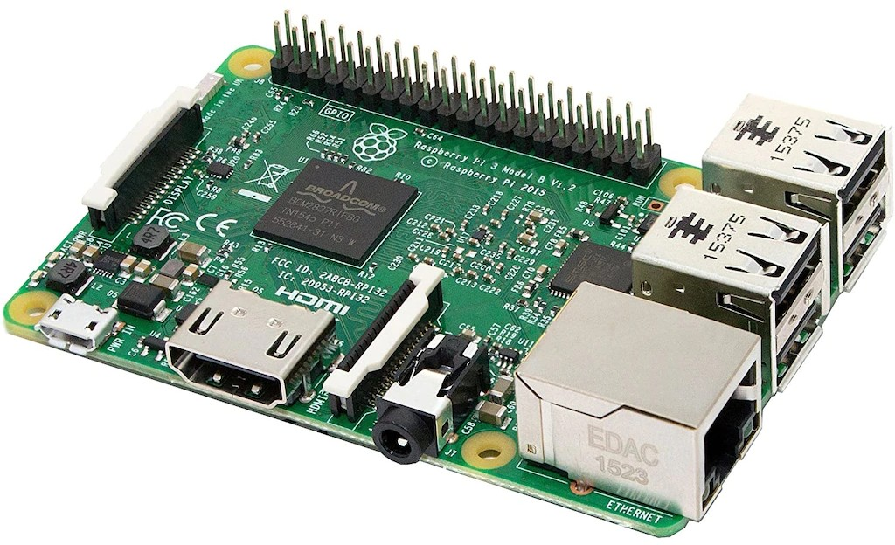
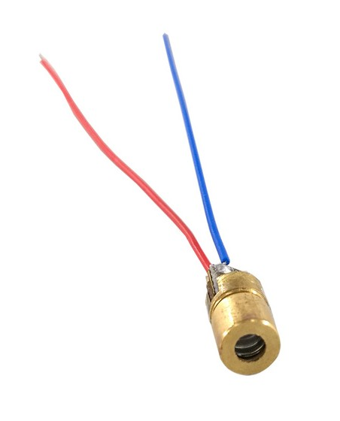
THE PARTS
Page 09 of 20
RASPBERRY PI 3 B
LASER

Slide 11
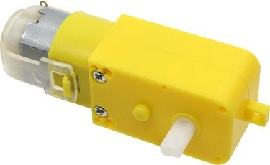
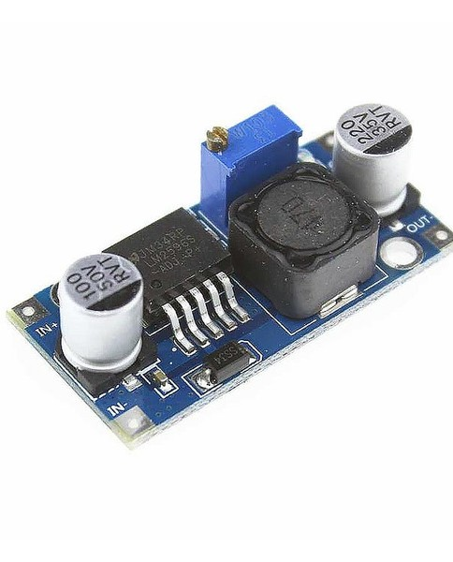
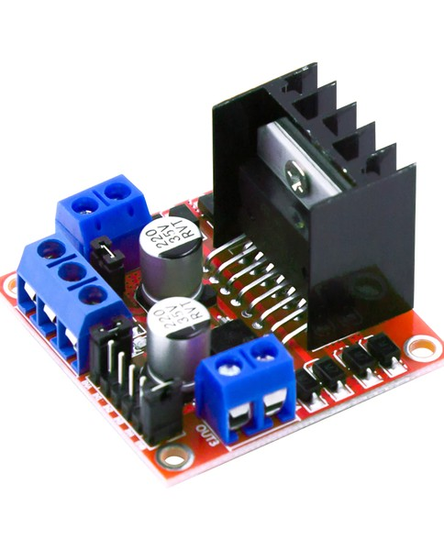
THE PARTS
Page 10 of 20
MOTOR
VOLTAGE STEPPER
MOTOR DRIVER BOARD

Slide 12
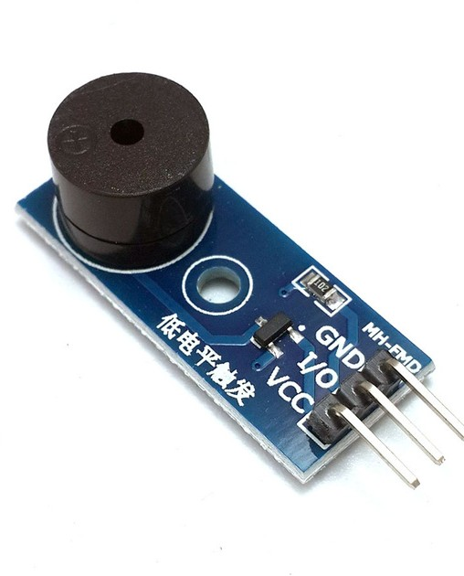
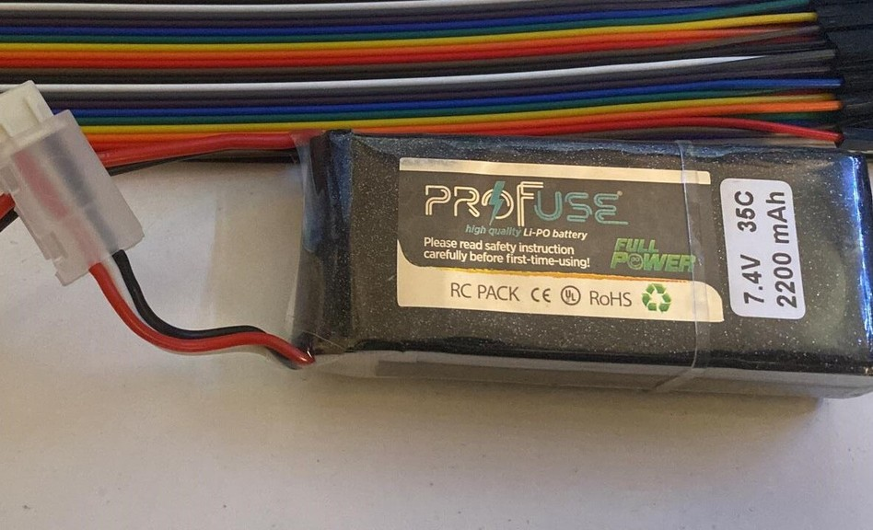
THE PARTS
Page 11 of 20
BUZZER
BATTERY

Slide 13
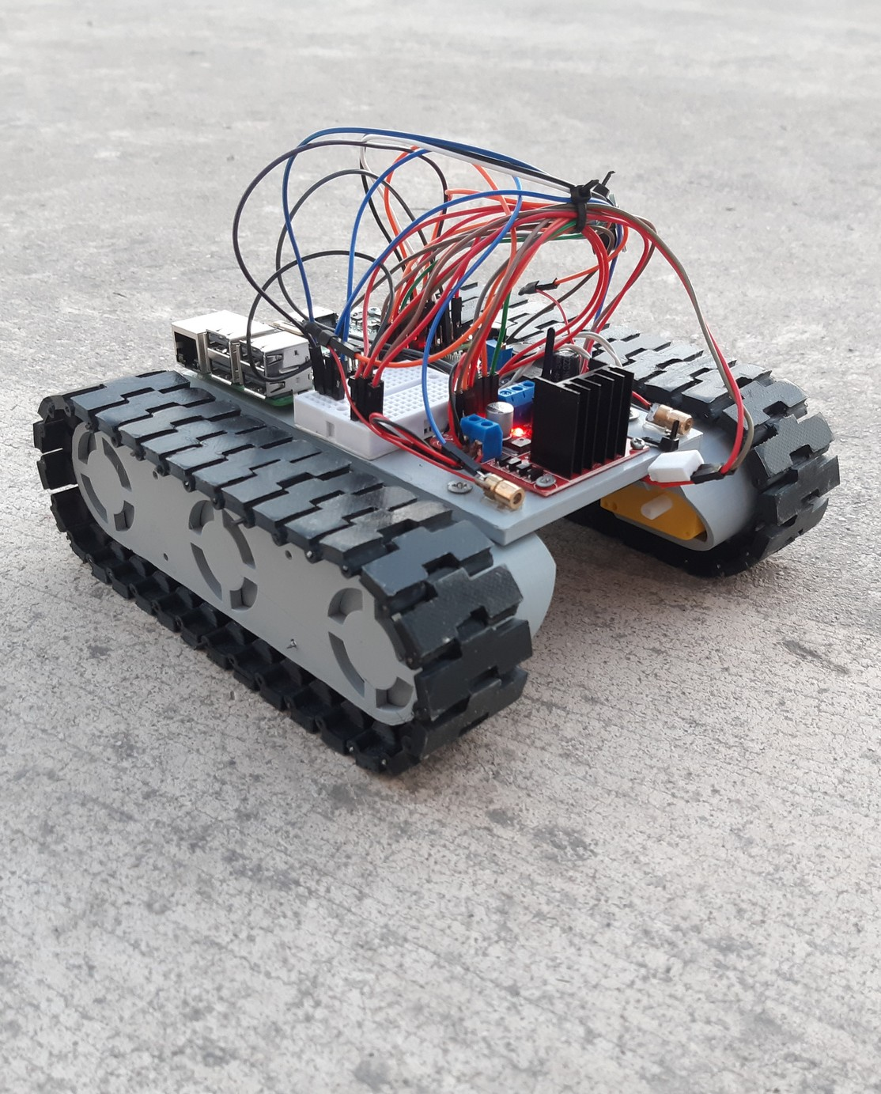
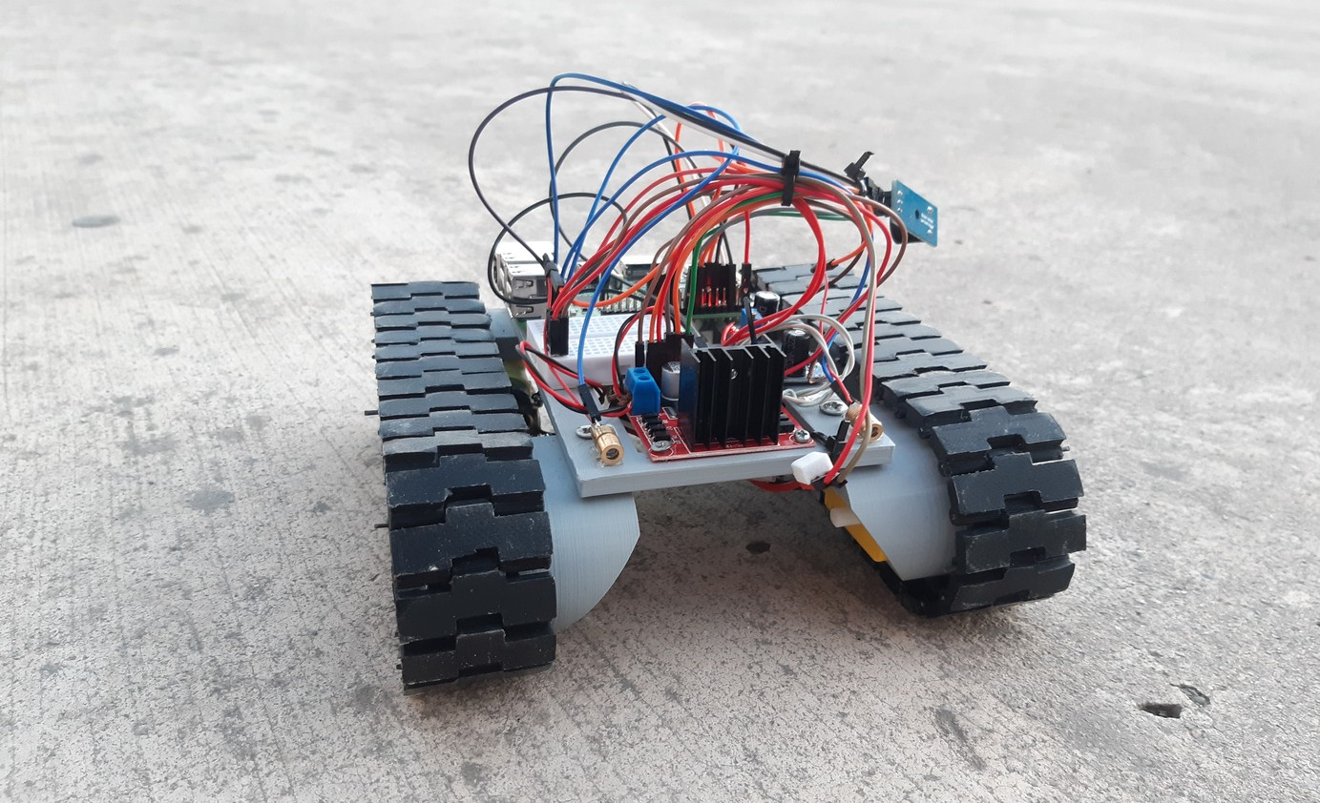
PIE TANK
The
Page 12 of 20

Slide 14
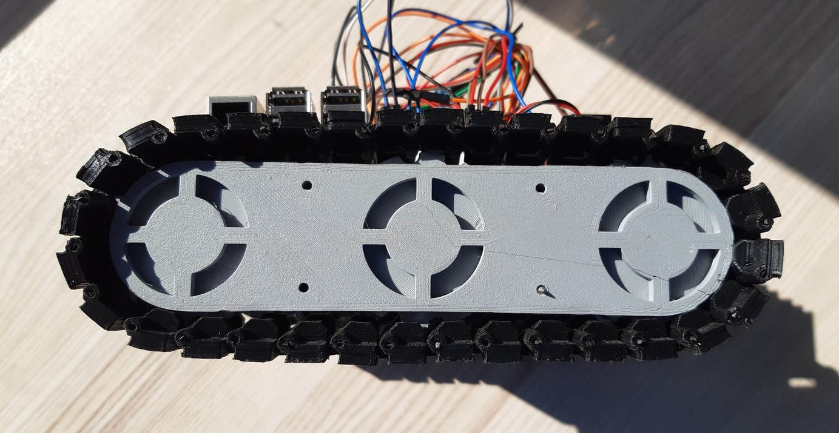
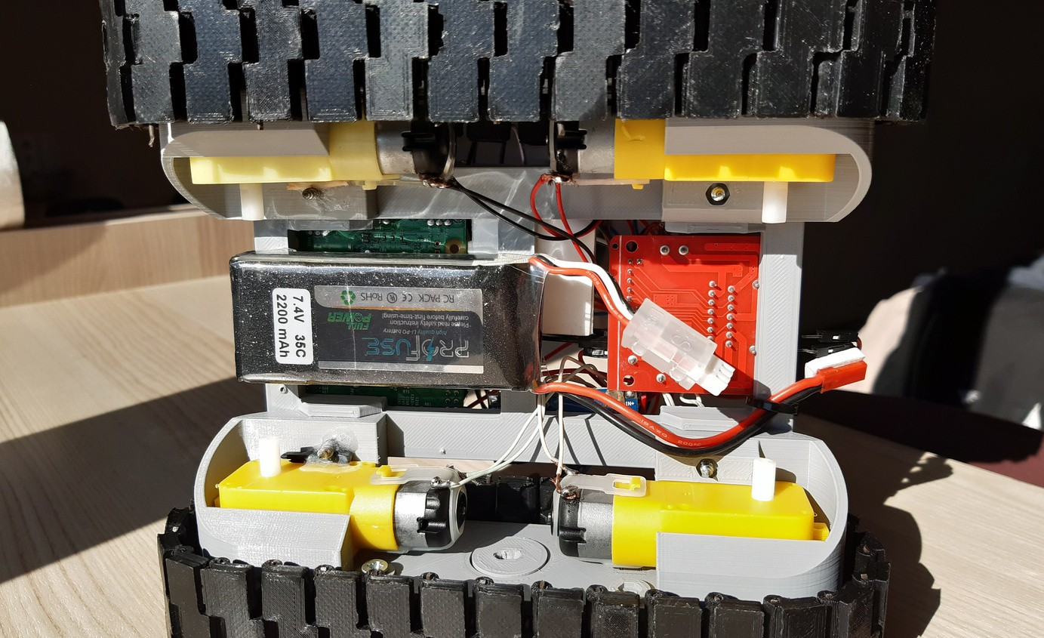
PIE TANK
The
Page 13 of 20

Slide 15
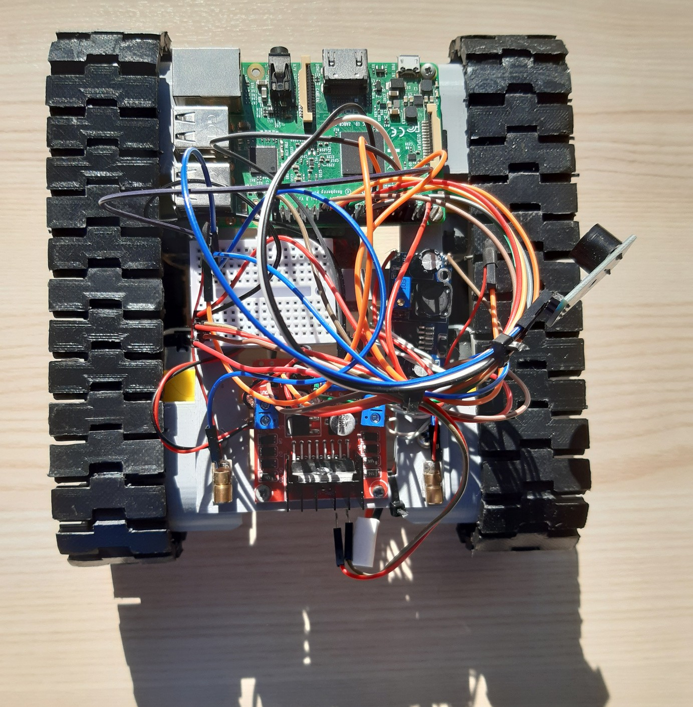
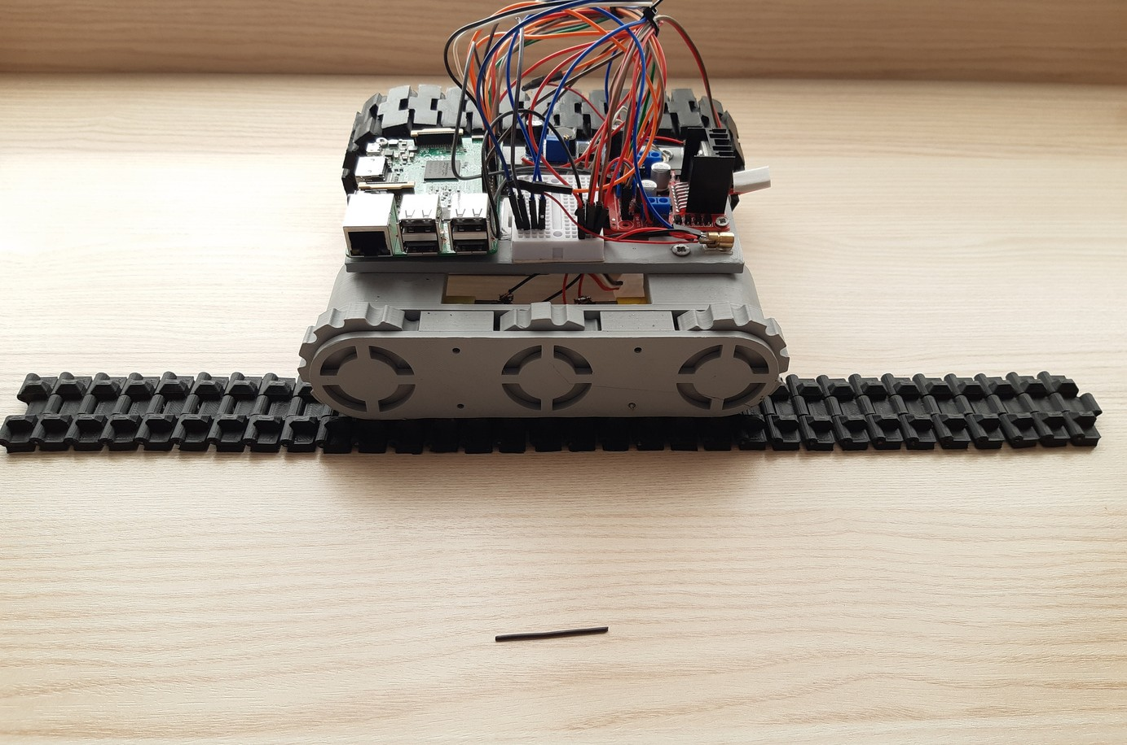
PIE TANK
The

Slide 16
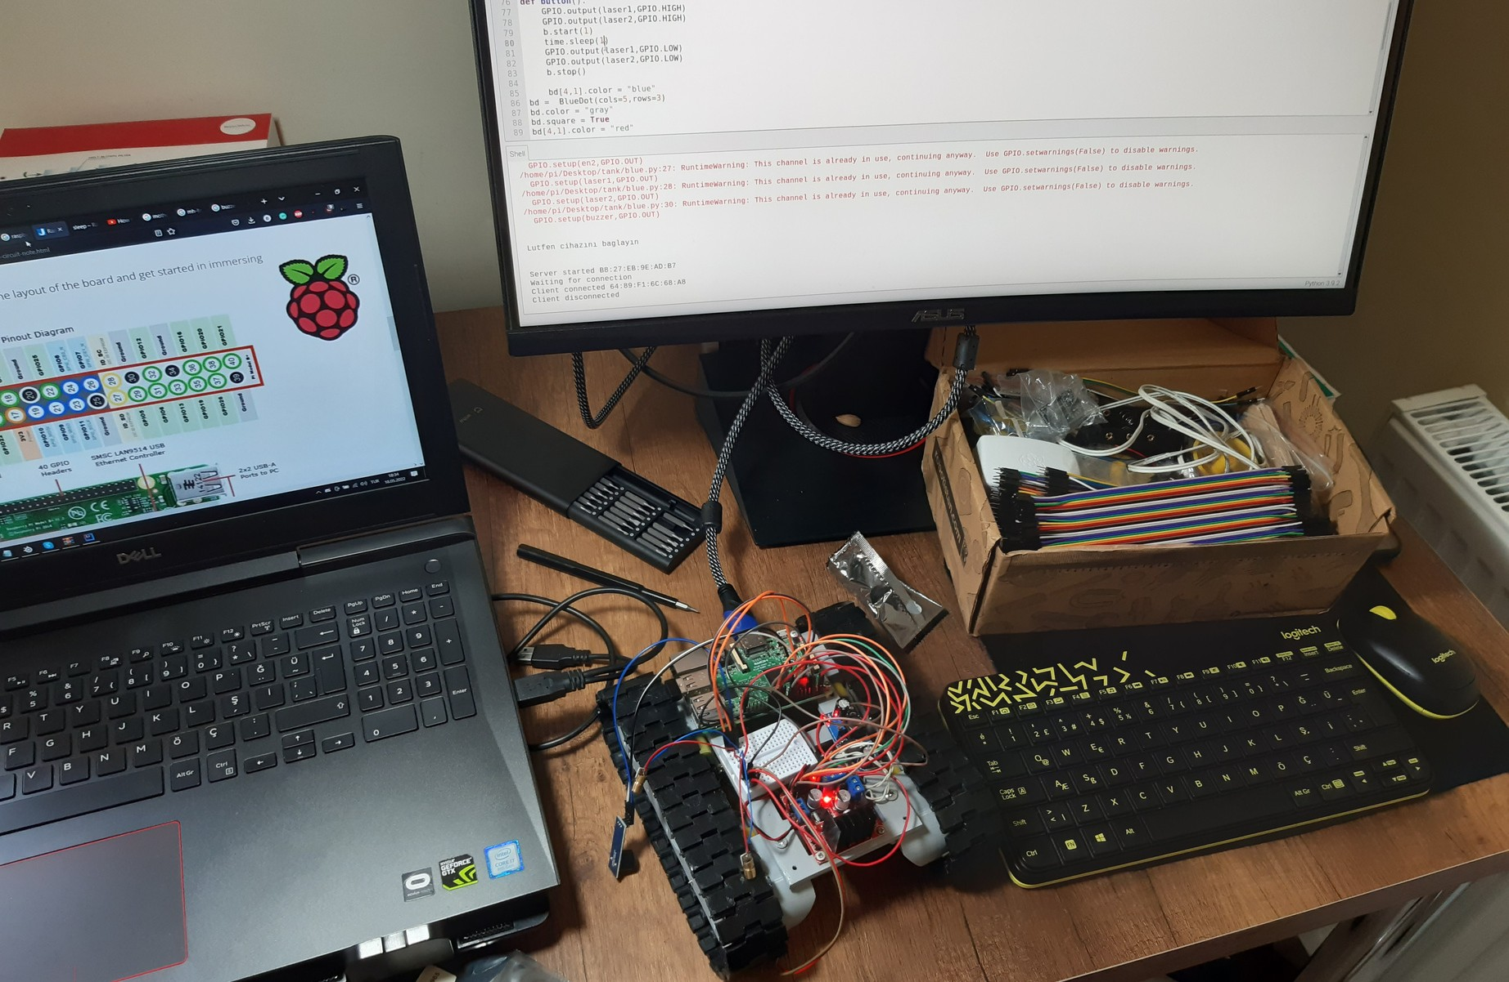
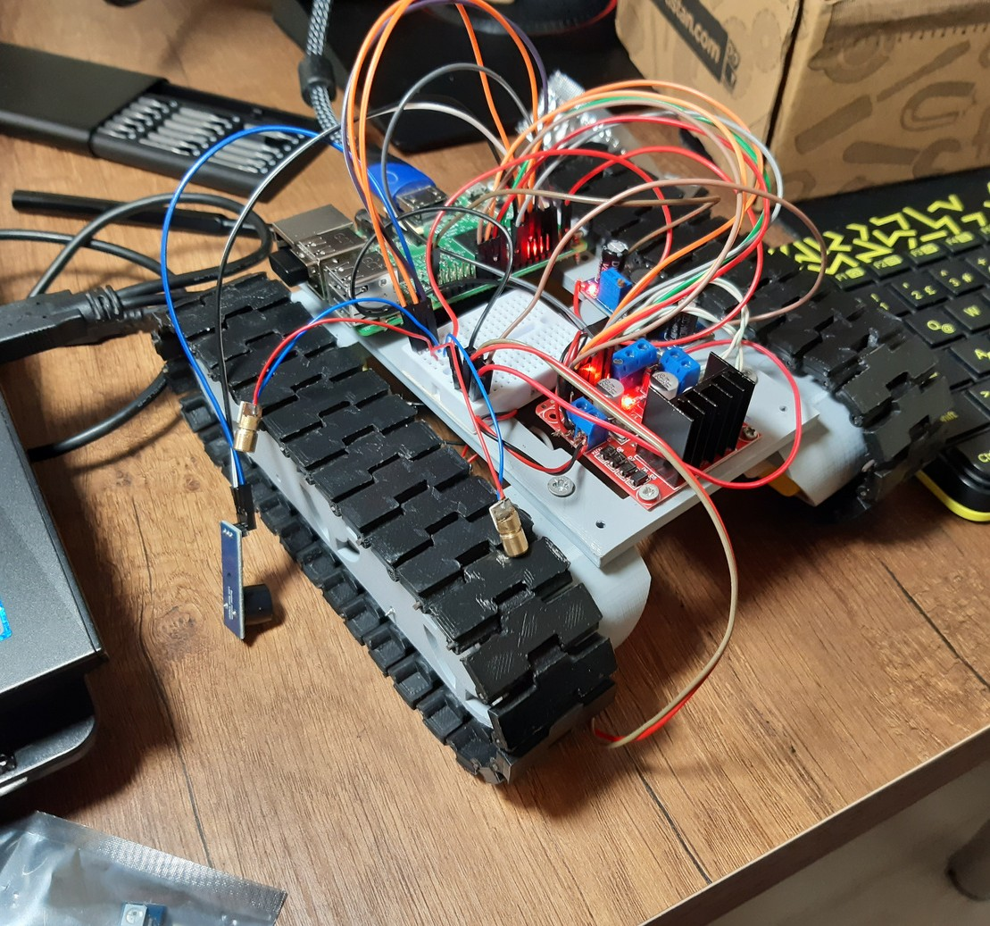
MAKING OF THE PIE TANK
Page 15 of 20
PROGRAMMING OF THE PIE TANK USING MICRO PYTHON
TESTING

Slide 17
Page 16 of 20
ABOUT TEAM WORK
In our team, every member had their own unique role and duty.

Slide 18
let's test
TOGETHER
Page 17 of 20

Slide 19
Page 18 of 20
Q&A

Slide 20
"IF YOU HAVE MADE MISTAKES, THERE IS ALWAYS ANOTHER CHANCE FOR YOU. YOU MAY HAVE A FRESH START ANY MOMENT YOU CHOOSE."
-MARY PICKFORD
Page 19 of 20
"EVERYTHING THAT HAPPENS HAPPENS AS IT SHOULD, AND IF YOU OBSERVE CAREFULLY, YOU WILL FIND THIS TO BE SO."
-MARCUS AURELIUS

Slide 21


Thank You

